Slide 1






Temporal Reasoning for Timeline Summarisation
in Social Media
Jiayu Song¹, Mahmud Elahi Akhter¹, Dana Atzil-Slonim², Maria Liakata³
Queen Mary University of London | Bar-Ilan University | The Alan Turing Institute
Speaker: Shiya Feng
Nov 18, 2025

Slide 2
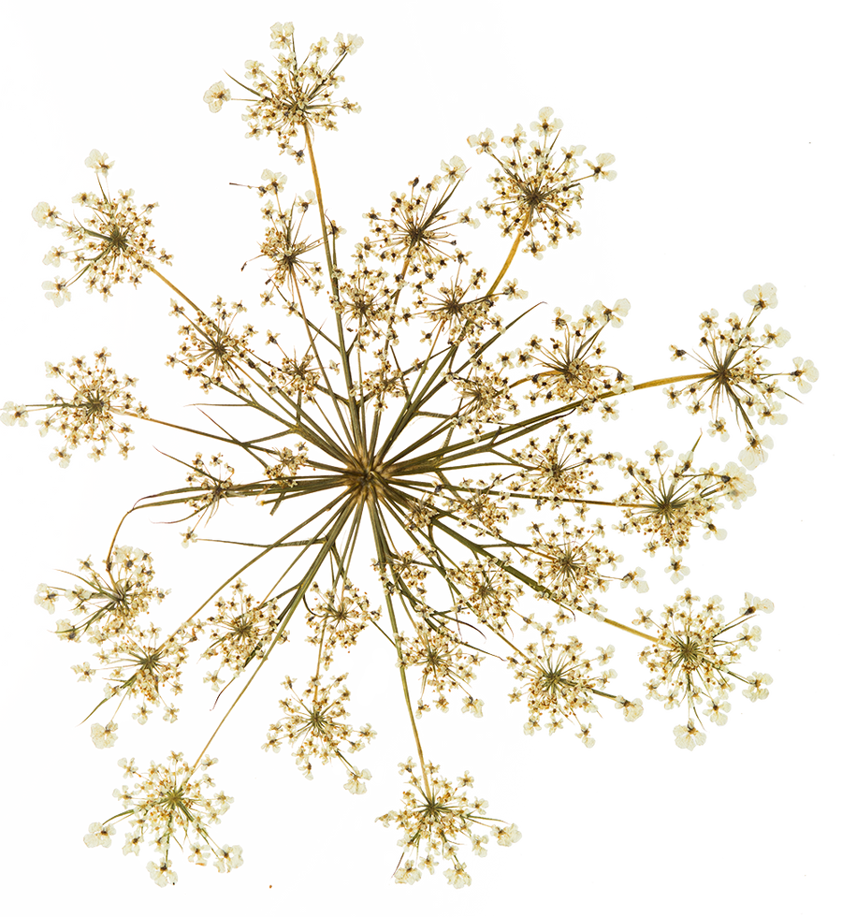

Content
1.Introduction
2.Methodology
3.Experiments
4.Results and Discussion
5.Conclusions
Nov 18, 2025 Temporal Reasoning for timeline summarisation in social media 1 / 26

Slide 3
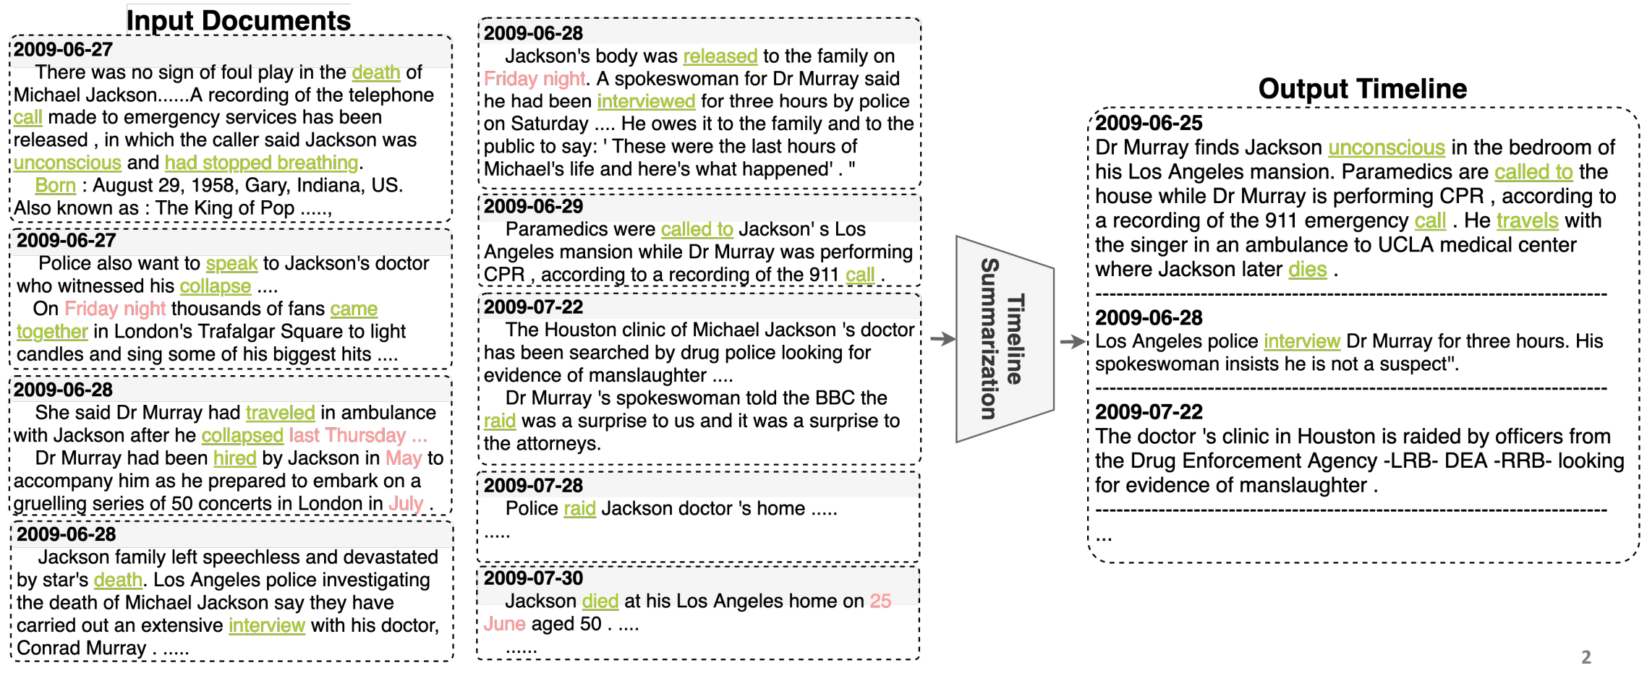
What is Timeline Summarisation?
It is creating concise summaries that capture changes of sequences of events over time.
Figure1. Timeline Summarization based on Event Graph Compression via Time-Aware Optimal Transport.
In Proceedings of the 2021 Conference on Empirical Methods in NLP, pages 6443–6456
Former methods: create event graphs / cluster event related timelines.
Author`s recent work: about social media timeline summarisation.
Nov 18, 2025 Temporal Reasoning for timeline summarisation in social media: Introduction 2 / 26

Slide 4

Why Temporal Reasoning matters
📖 Example Story:
"Sarah woke up early in the morning. She prepared breakfast before heading to work. While she was driving to the office, she listened to her favorite podcast. She arrived at work just in time for the morning meeting."
Temporal Reasoning = understand time-based relationships between events
Its apply on LLM
Its benefits for timeline summaries
🤖 Events Extracted:
Event 1; Event 2; Event 3; Event 4; Event 5
⏰ what Temporal Reasoning identifies:
Event 1 BEFORE Event 2
Event 2 BEFORE Event 3...
Woke up
Prepared breakfast
Drove + Listened
Arrived
Nov 18, 2025 Temporal Reasoning for timeline summarisation in social media: Introduction 3 / 26

Slide 5
The Challenge in this Paper
What's the Problem?
a. Social media posts tell stories over time.
b. Events happen without clear timestamps.
c. Mental health posts are especially complex:
Mixed emotions;
Repeated events;
Need context to understand.
Question: Can better temporal reasoning help LLMs create better summaries?
Nov 18, 2025 Temporal Reasoning for timeline summarisation in social media: Introduction 4 / 26

Slide 6
The Gap in Current Research
What we know:
a. LLMs struggle with temporal reasoning.
b. Temporal reasoning is important for understanding narratives.
What is missing:
c. No one has explored HOW improving temporal reasoning helps downstream tasks.
d. Most work focuses on improving reasoning, not applying it.
Nov 18, 2025 Temporal Reasoning for timeline summarisation in social media: Introduction 5 / 26

Slide 7



Our Approach Overview
student model also learns timeline summarisation
fine-tune large
teacher model
test student model on different domain (mental health)
teacher model transfer knowledge to smaller student model
temporal
reasoning
dataset
timeline
summarisation
dataset
another
domain
dataset
Goal: given an individual`s timeline, then generate an abstractive summary that reflects changes in the individual over time.
Nov 18, 2025 Temporal Reasoning for timeline summarisation in social media: Introduction 6 / 26

Slide 8
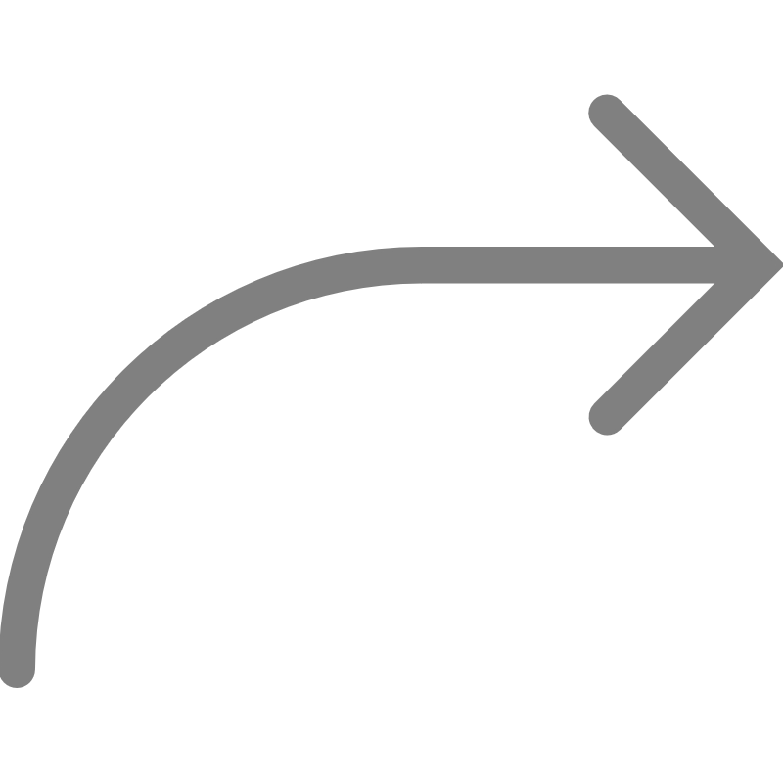

How to build temporal reasoning dataset
——NarrativeReason
Problem with existing dataset (NarrativeTime)
Why?
How to solve?
Its shortage: only focus on the type of event, annotate verb, only conduct a dense annotation, not event triples.
annotate TLink (e.g: before, after, during) to events, give temporal relations to events.
restructure
TimeBankDense(Cassidy¹)
NarrativeTime(Rogers²)
NarrativeReason
[1]Cassidy et al., ACL 2014 [2] Rogers et al., LREC/COLING 2024
Nov 18, 2025 Temporal Reasoning for timeline summarisation in social media: Methodology 7 / 26

Slide 9
How to build temporal reasoning dataset
——NarrativeReason
What we did for restructure:
1. extracted events as relational triples.
--e.g: <Indonesian stock market value, fallen, by twelve percent>
2. created question-answer pairs for all event relationships.
-- question format: "What is the temporal relation between Event A and Event B?"
--answer: BEFORE/AFTER/INCLUDES/IS_INCLUDED/SIMULTANEOUS
restructure
Dataset contains
19614 question/answer pairs
Answer pairs is their
key difference
TimeBankDense(Cassidy¹)
NarrativeTime(Rogers²)
NarrativerrReason
[1]Cassidy et al., ACL 2014 [2] Rogers et al., LREC/COLING 2024
Nov 18, 2025 Temporal Reasoning for timeline summarisation in social media: Methodology 8 / 26

Slide 10
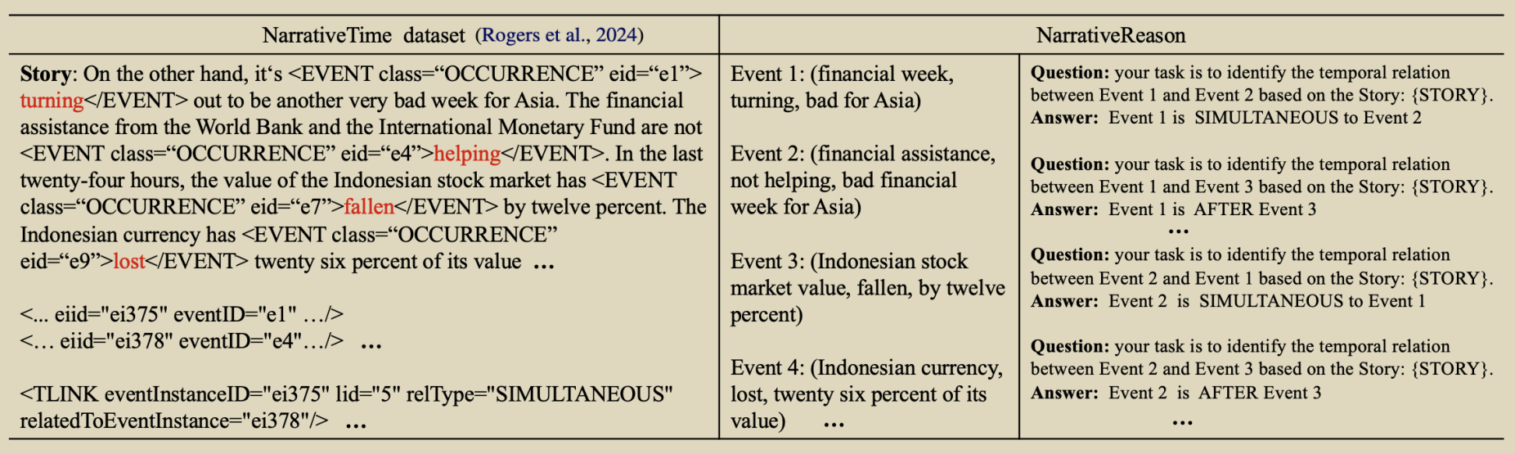
NarrativeReason vs. NarrativeTime dataset
Figure 2. The temporal relations between events
Left column: filtered NarrativeTime to keep only verbs.
Middle column: events triggered by verbs using relational triples.
Right column: construct question/answer pairs for all events.
Nov 18, 2025 Temporal Reasoning for timeline summarisation in social media: Methodology 9 / 26

Slide 11



How to fine-tune for Teacher Model
Apply supervised fine tuning (SFT) on a large LLM (teacher model).
Input: temporal questions
Output: corresponding answers
How to verify the fine-tuned result?
--used TEMPREASON dataset
--used F1 as the evaluation metrics
--the fine-tuned model achieved a 0.07 improvement
fine-tune large
teacher model
temporal
reasoning
dataset
(NarrativeReason)
timeline
summarisation
dataset
another
domain
dataset
Nov 18, 2025 Temporal Reasoning for timeline summarisation in social media: Methodology 10 / 26

Slide 12
Transfer temporal reasoning knowledge to Student Model
📝 Example Input: timeline summarization task
Post 1 (Jan 5): I lost my job today. Feeling upset.
Post 2 (Jan 12): Started therapy this week. It's helping.
Post 3 (Jan 20): Applied to 5 new positions. Feeling hopeful.
Student learns BOTH temporal reasoning AND summarization simultaneously.
👩‍ Teacher Model
LLaMA-3-8B
-- fine-tuned before
-- knows temporal reasoning
🔒 FROZEN (Parameters Fixed)
Teacher's Understanding:
• "lost job" BEFORE "started therapy"
• "started therapy" BEFORE "applied"
🎯 Student Model
Phi-3-mini-4k
-- learning timeline summarization
-- receiving temporal knowledge
🎓 TRAINING (Update Parameters)
Student's Learning:
• Mimics teacher's representations
• Combines both skills:
- Temporal reasoning (from Teacher)
- Summarization (from Data)
how to train?
Nov 18, 2025 Temporal Reasoning for timeline summarisation in social media: Methodology 11 / 26

Slide 13

How did Knowledge transfer
a. L_{PKT} - Probabilistic Knowledge Transfer
Matches probability distributions between teacher and student outputs.
L_PKT = KL(p_teacher || p_student)
b. L_{NST} - Neuron Selectivity Transfer
Transfers activation patterns from teacher to student neurons.
L_NST = MMD²(T, S)
Student model training:
a combination of knowledge distillation losses+language modeling loss L_{language}.
c. L_{CRD} - Contrastive Representation Distillation
Maximizes mutual information between teacher and student representations.
L_CRD = -log[h(s,t)_positive]
d. L_{language} - Language Modeling Loss
Standard next-token prediction loss for timeline summarization task.
L_language = CrossEntropy(y_pred, y_true)
In each experiment,
Total Loss = L_{PKT} + L_{language} OR
Total Loss = L_{NST} + L_{CRD} + L_{language} OR
Total Loss = L_{PKT} + L_{CRD} + L_{language} OR
......
✅ Student's Output (After Training):
``The individual experienced job loss in early January, leading to emotional distress. They initiated therapy shortly after, which provided support. Subsequently, they took proactive steps by applying for new positions, demonstrating resilience.``
-- Maintains correct temporal order (thanks to teacher's knowledge)
-- Creates coherent summary (thanks to timeline summarization training)
Nov 18, 2025 Temporal Reasoning for timeline summarisation in social media: Methodology 12 / 26

Slide 14


How to verify: Mental Health Timeline Summary
Apply the student model to other domains, to generate summaries for each timeline from dataset.
test student model on different domain (mental health)
temporal
reasoning
dataset
timeline
summarisation
dataset
another
domain
dataset
Nov 18, 2025 Temporal Reasoning for timeline summarisation in social media: Methodology 13 / 26

Slide 15
Experimental Setup--Datasets
NarrativeReason (training teacher)
--668 events extracted
30 articles
19614 temporal relations
19614 question/answer pairs
--use these question/answer pairs to fine-tune teacher model to enhance its temporal reasoning capability.
Timeline Summarisation Dataset (training student)
--5000 timelines and summaries from Wikipedia
--News domain
TalkLife (testing)
--30 anonymised users` mental health timelines
--augmented them with corresponding mental health-related summaries and associated evidence
Nov 18, 2025 Temporal Reasoning for timeline summarisation in social media: Experiments 14 / 26

Slide 16
What Models & Baselines were used
Main models
L-Phi & P-Phi
Control models
--to prove why the main models work.
1. Phi_{joint} : test if the special "Teacher-Student" method is necessary
2. KD_{timeline} : test if temporal reasoning part is important.
3. KD_{origin} : test if Teacher Model needs to be fine-tuned at all.
Baseline models
1. Phi_{temp} : Phi model fine-tuned only on the temporal reasoning dataset.
2. Phi_{tl} : Phi model fine-tuned only on the timeline summarization dataset.
Benchmark models
LLaMA-3 & Phi_{ICL} & TH-VAE
Nov 18, 2025 Temporal Reasoning for timeline summarisation in social media: Experiments 15 / 26

Slide 17
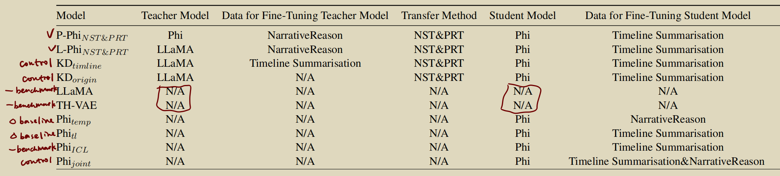

What Models & Baselines were used
Table 1. All the different models we consider
Several key comparisons to test main idea:
L-Phi vs. Phi_{joint}
L-Phi vs. KD_{timeline} and KD_{origin}
L-Phi vs. LLaMA, Phi_{ICL}, and TH-VAE
L-Phi vs. Phi_{temp} and Phi_{tl}
L-Phi vs. P-Phi
Nov 18, 2025 Temporal Reasoning for timeline summarisation in social media: Experiments 16 / 26

Slide 18

Evaluation Metrics
when score is higher, summary is more reliable
Automatic metrics:
--Factual Consistency (FC): does summary match the original timeline facts?
--Evidence Appropriateness (EA): does summary match human-written summaries?
Human evaluation:
🧑‍ 👩‍ evaluated by two clinical psychology graduate students
--Factual Consistency (FC)
--Usefulness (General/ Diagnosis/ Interpersonal/ Moments of Change)
Nov 18, 2025 Temporal Reasoning for timeline summarisation in social media: Experiments 17 / 26

Slide 19
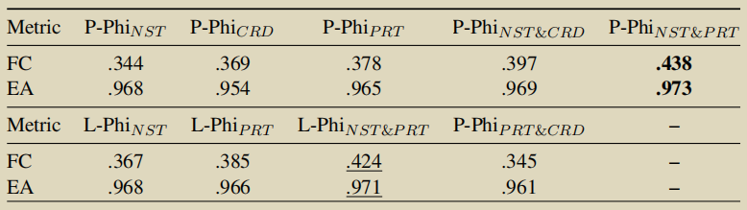
Results for Distillation Methods
when score is higher, summary is more reliable
Table 2. Automatic evaluation for FC, EA for timeline summarisation of the different KD strategies
Best individual method: PKT (FC=0.378)
Best combination: NST + PKT ( FC=0.438 for P-Phi, FC=0.424 for L-Phi)
Why PKT and NST work well:
-- Both match structural consistency
-- Important for maintaining temporal coherence
-- CRD focuses on separating instances (less helpful here)
Nov 18, 2025 Temporal Reasoning for timeline summarisation in social media: Results and Discussion 18 / 26

Slide 20
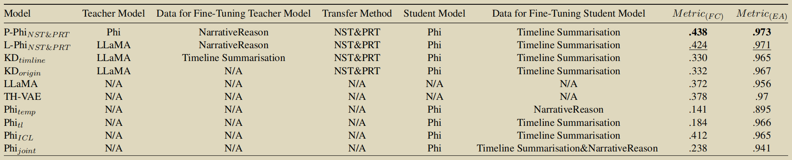
Results for Automatic Evaluation
main model
control model
benchmark model
Table 3. Automatic evaluation for FC, EA for timeline summarisation of all the different models we consider
P-Phi and L-Phi performed best.
Phi_{temp} and Phi_{tl}`s FC scores: fine-tuning on a single dataset does not improve model performance.
Performance of Phi_{joint} was worse than just using in-context learning to guide the LLM (Phi_{ICL}).
Temporal reasoning ignificantly reduce hallucination in the model`s output.
Nov 18, 2025 Temporal Reasoning for timeline summarisation in social media: Results and Discussion 19 / 26

Slide 21
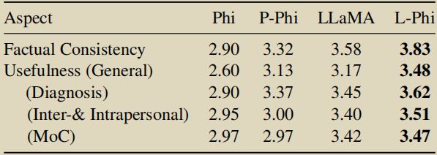
Results for Human Evaluation
Table 4. Human evaluation results based on 5-point Likert scales (1 is worst, 5 is best)
Clinical psychologists prefer L-Phi across ALL aspects.
fine-tuned model significantly reduces hallucination.
But fine-tuned model did not show much improvement in terms of Moments of Change (MOC).
Nov 18, 2025 Temporal Reasoning for timeline summarisation in social media: Results and Discussion 20 / 26

Slide 22
Why knowledge distillation works
Analyze from a representation learning perspective why the L-Phi model performs better.
We analyzed internal representations using:
1. UMAP projections of last layer activations
2. Centered Kernel Alignment (CKA) similarity
Nov 18, 2025 Temporal Reasoning for timeline summarisation in social media: Results and Discussion 21 / 26

Slide 23
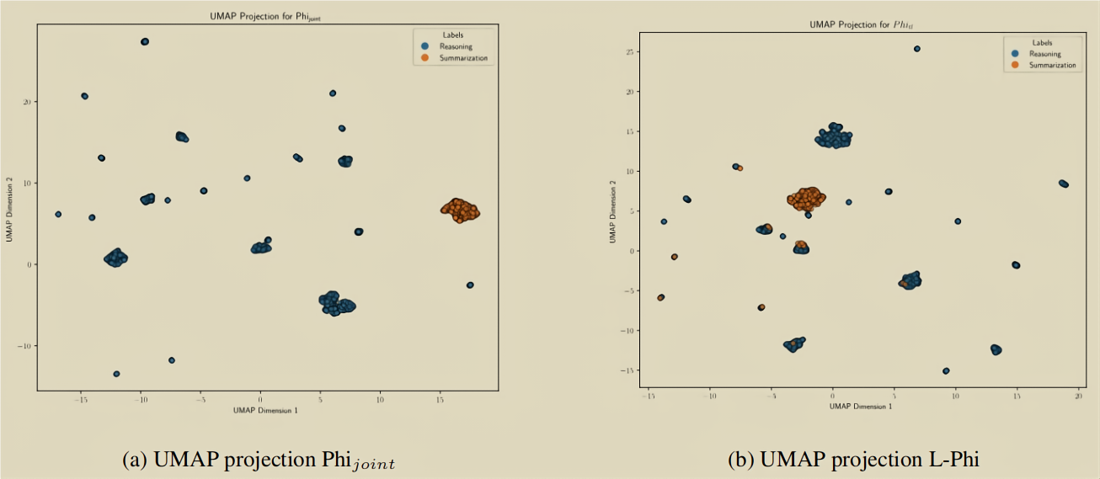



Why knowledge distillation works
Use UMAP to project the activations to lower dimensions:
Polysemantic neurons
neurons that respond to multiple task aspects
better learned representations
L-Phi: Overlapping activations (polysemantic neurons)
Figure 3. The UMAP projection for Phi_{joint} and L-Phi show the last layer activations for both models
Phi_{joint}: Well-separated activations (task-specific neurons)
Nov 18, 2025 Temporal Reasoning for timeline summarisation in social media: Results and Discussion 22 / 26

Slide 24
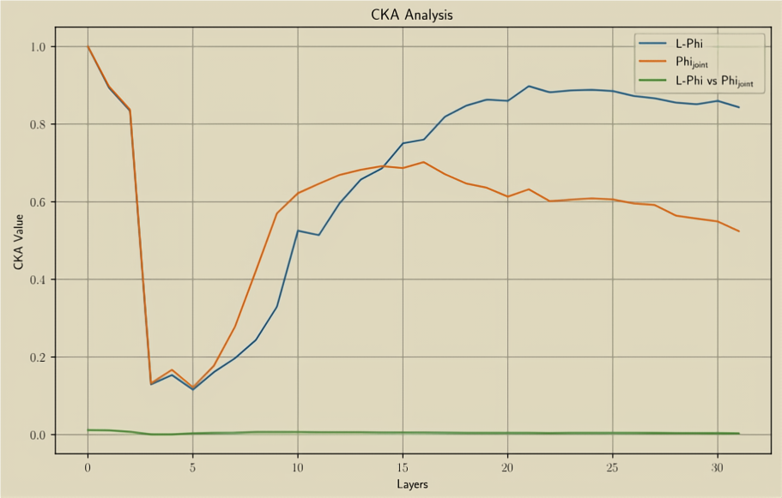
How to verify this Hypothesis
--using CKA similarity
L-Phi shows:
--Gradual increase in CKA across layers
--Peak in mid-to-late layers
--Preserves and refines information from initial embeddings
Phi_{joint} shows:
--Initial increase then flattens early
--Lower CKA in later layers
--Fails to refine representations effectively
CKA measure the similarity between internal representations of models.
Figure 4. CKA similarity score of within and between L-Phi and Phi_{joint} model representations
Nov 18, 2025 Temporal Reasoning for timeline summarisation in social media: Results and Discussion 23 / 26

Slide 25

Key Insights
teacher model transfer knowledge to student model
teacher model
student model
NarrativeReason
timeline
summarisation
dataset
TalkLife
What we learned:
Temporal reasoning dramatically reduces hallucinations.
Fine-tuning on single dataset DOES NOT help (Phi_{temp} , Phi_{tl} performed poorly).
Simply mixing datasets fails (Phi_{joint} worse than in-context learning).
Knowledge distillation successfully integrates temporal reasoning with summarisation.
Larger teacher models provide better knowledge.
Nov 18, 2025 Temporal Reasoning for timeline summarisation in social media: Conclusions 24 / 26

Slide 26
Conclusions
What author has done in the paper?
1. First to explore how temporal reasoning improves timeline summarisation.
2. Created NarrativeReason dataset for temporal reasoning focus on event sequences.
3. Used knowledge distillation to transfer temporal reasoning to smaller models.
4. Applied to timeline summarisation in different domain (mental health).
What is the result of main model?
1. Best performance on mental health timeline summarisation.
2. Significantly reduced hallucinations.
3. Better learned representations through knowledge distillation.
Nov 18, 2025 Temporal Reasoning for timeline summarisation in social media: Conclusions 25 / 26

Slide 27




Limitations
1
2
1. Existing mental health knowledge in LLMs.
2. Should use fixed formats of mental health-related texts.
Tendency to make definitive DSM diagnoses posts.
1. Sometimes lack personalization.
2. Can affect depth and factual consistency.
Future direction: Refine models for better understanding of social media mental health posts.
Nov 18, 2025 Temporal Reasoning for timeline summarisation in social media: Conclusions 26 / 26

Slide 28
Thanks for listening

